Slide 1
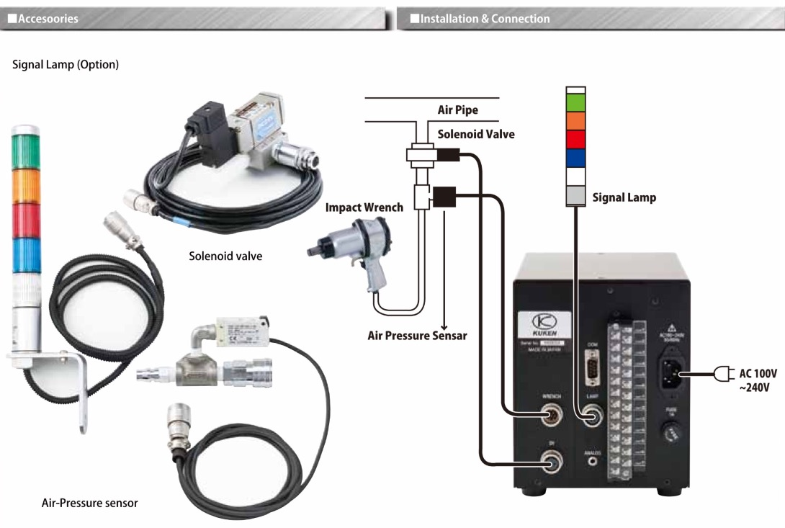
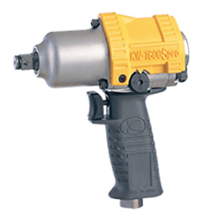
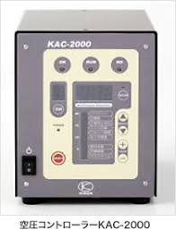
POKA YOKE System from KUKEN
Can count no of impact or pulse

Slide 2
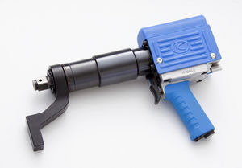
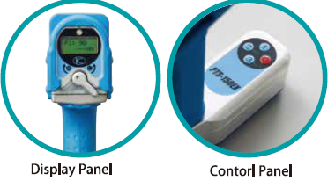
Advanced Torque Control Tool
PTS (Power Torque Setter)
Extremely accurate(5%)
Reaction is absorbed through reaction arm
3 different torques can be set .
Data saving system
Extremely Low Vibration & Noise
High Torque range:5000Nm.
Programmable.
Torque display is there.
Starts from 25 Nm.

